Slide 1

Modelling water flow

Slide 2
Why understand water flow?
Marine biology occurs in water.
Water flow is more influential for marine systems than air flow is to terrestrial systems.
Interactions with hydrodynamics are important.
In many applied modeling project, hydrodynamics dominates because it is more predictable.

Slide 3
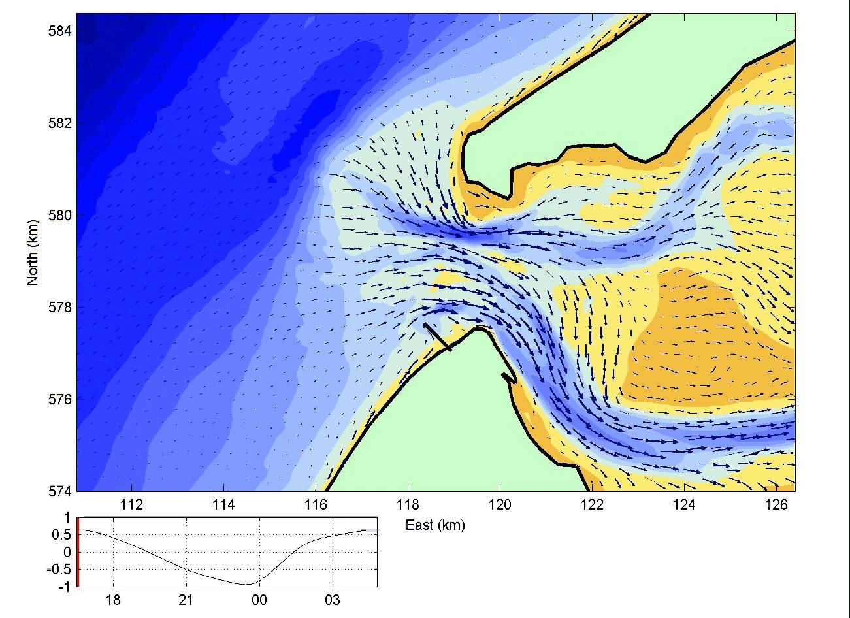

Slide 4
Modelling water flow
Only one species: H₂O
Governing processes: gravity & friction
Modeling requires you to keep track of mass and energy
No odd “behavioral” processes: high potential predictability
Why can’t biologists make similar good models?

Slide 5
Today...
Basics of Hydrodynamics
Interplay of vegetation and water flow
Biogeomorphology

Slide 6
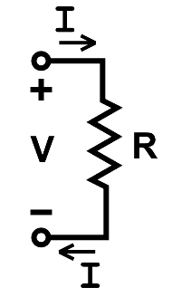
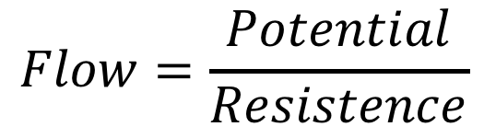
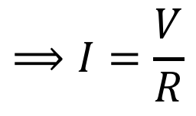
Remember Ohm’s law for electricity
To calculate flow
$$Flow=\frac{Potential}{Resistence}$$
$$⟹I=\frac{V}{R}$$
Georg Simon Ohm
1789 –1854
Germany

Slide 7
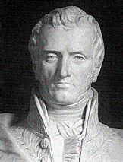
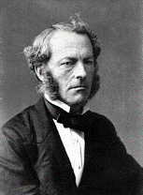
Water flow from first principles
The physical laws governing water flow:
Conservation of mass
Conservation of momentum
Claude-Louis Navier
(1785-1836)
Navier-Stokes equation: a mathematical equation describing water flow:
where
Here, u, v, w are the flow rate in x, y, and z dimension,
ν is viscosity, P is the pressure, and ρ is the fluid density
George Gabriel Stokes
(1819-1903)
http://mathworld.wolfram.com/Navier-StokesEquations.html

Slide 8
Processes governing flow
Pressure (heat) & gravity are the main driving forces
Conservation of mass and momentum
No water gets lost
Kinetic energy (moment) doesn’t get lost (mysteriously)
Momentum is lost through
Friction with bottom or other surfaces
Viscous turbulence generation
Additional “forces”: Coriolis force at large scales

Slide 9
Navier-Stokes Equations
Momentum equations
Continuity equation

Slide 10
Navier-Stokes equations
Navier-Stokes equations for an incompressible fluid (~water)
Momentum conservation
Mass conservation

Slide 11
Shallow water equations
Simplification: shallow water
Horizontal scale >> Vertical scale (e.g. an estuary of 50 km long, ~10 meters deep)
Flow in z dimension is ignored
Pressure only due to water surface elevation difference, multiplied by gravity g.
=> “Shallow water equations”

Slide 12
Shallow water equations
Momentum
conservation:
Mass
conservation:
Where surface elevation η = h + s. Here h is the height of the water column from the bottom to the surface, and s is the elevation of the bottom. b stands for energy loss to turbulence.

Slide 13
Shallow water equations
Momentum
conservation:
Mass
conservation:
h
v
u
η=h+s
s

Slide 14
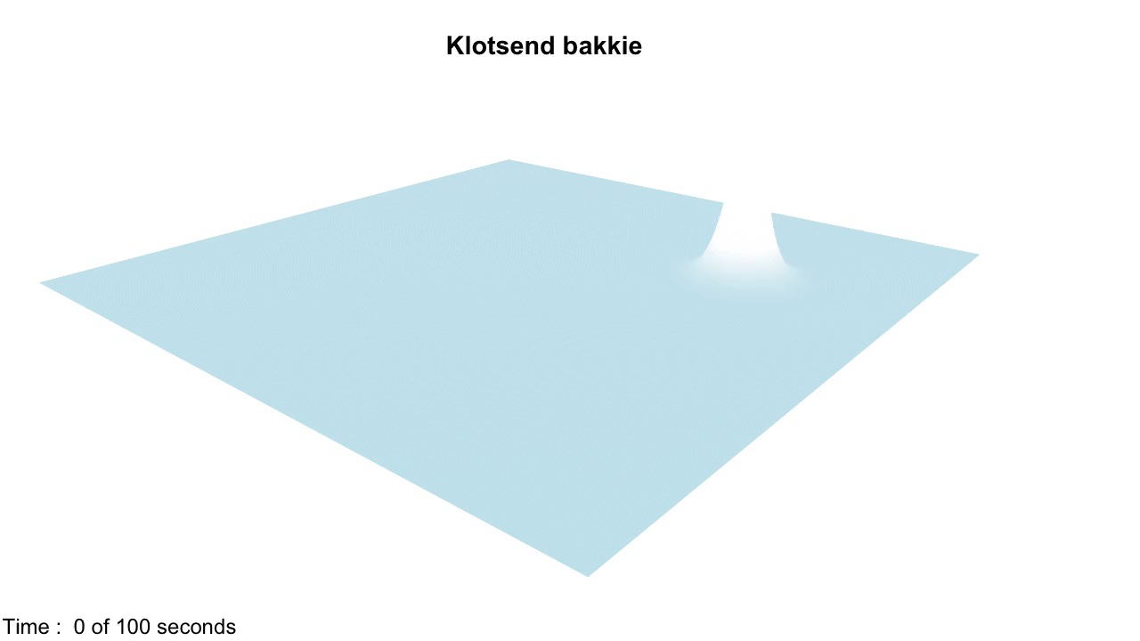
The bathtub model
https://en.wikipedia.org/wiki/Shallow_water_equations

Slide 15

Example: a tsunami
https://www.youtube.com/watch?v=MSC8TPOt8bc

Slide 16
What about bottom friction?
Bottom friction:
The momentum transfer at the lower boundary of the water column to the solid earth by friction with the bottom.
Τ_{b} = Stress imposed by the bottom
ρ = Density of the water
h = Water height

Slide 17
What about bottom friction?
Water speed

Slide 18
The Chézy equation for bottom friction
where |u| is the absolute flow velocity in all dimensions. C_{b} and |u| are given by:
C = Chézy roughness coefficient (44 for the river Seine)
g = gravity.
R = hydraulid radius (of a pipe), which can be replace by h
n = Manning’s coefficient for bottom roughness
For values, see: http://www.engineeringtoolbox.com/mannings-roughness-d_799.html

Slide 19
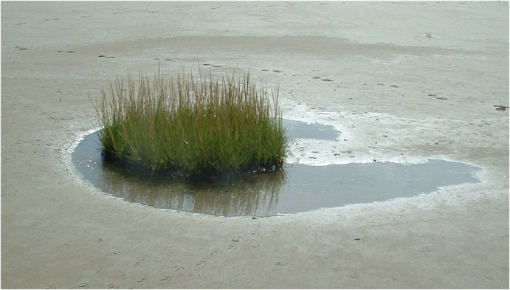
Tussock effects

Slide 20
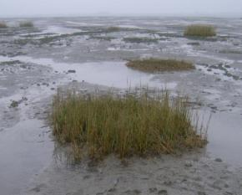
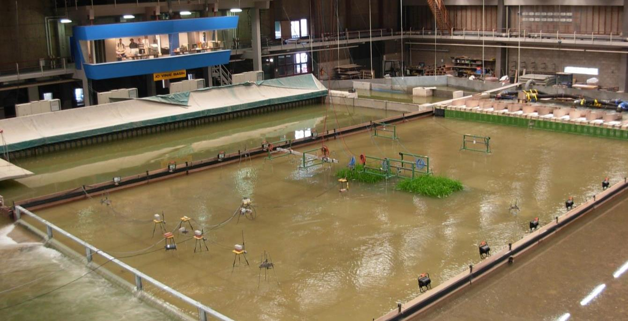
How bio-physical feedbacks lead to SELF-ORGANISATION in tidal wetlands
Flow interaction with vegetation patches
Vegetation patches in a lab flume study
16m
26m
FLOW
Bouma et al (2013) Geomorphology

Slide 21
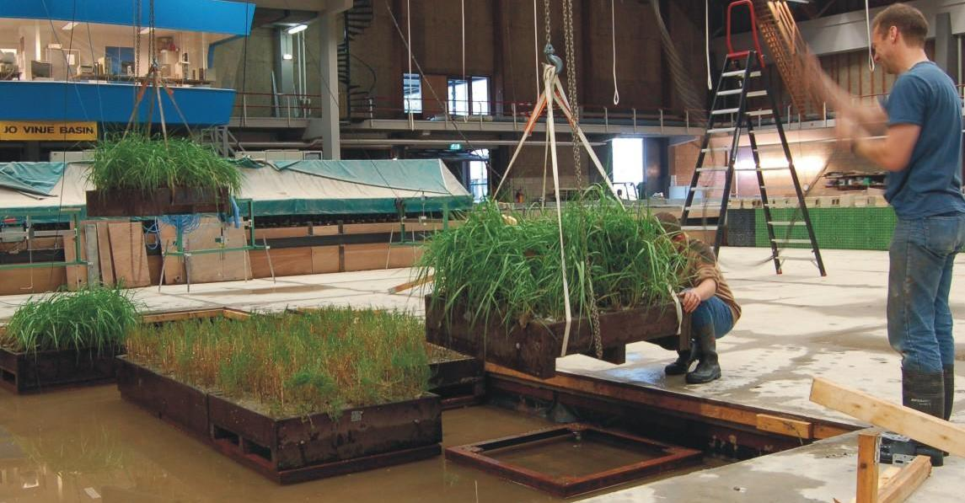
How bio-physical feedbacks lead to SELF-ORGANISATION in tidal wetlands
Flow interaction with vegetation patches
Vegetation patches in a lab flume study
26m
Vandenbruwaene at al. (2011) J.Geophys.Res.

Slide 22
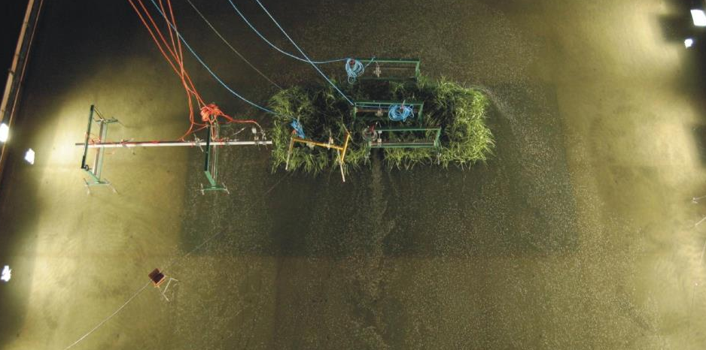
How bio-physical feedbacks lead to SELF-ORGANISATION in tidal wetlands
FLOW
Flow acceleration
Flow acceleration
Flow reduction
TOPVIEW
Spartina anglica patches in a large flume
Bouma et al (2013) Geomorphology

Slide 23
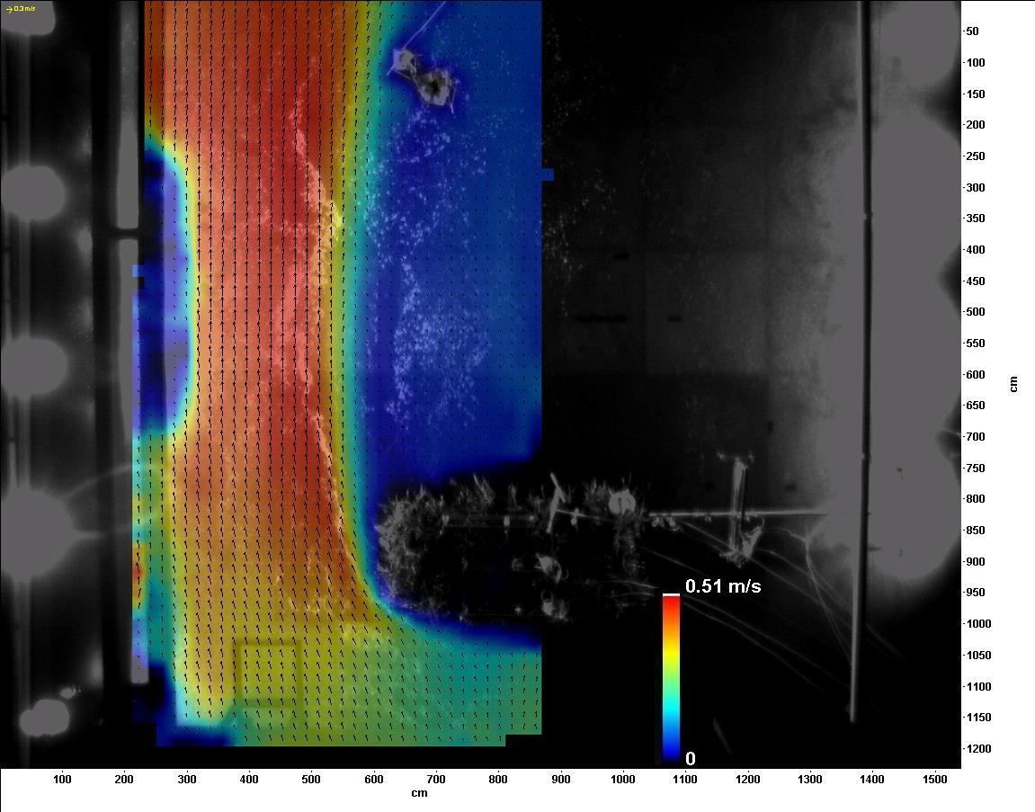
How bio-physical feedbacks lead to SELF-ORGANISATION in tidal wetlands
Top view
Flow reduction
Flow acceleration
FLOW DIRECTION
Stiff emergent Spartina
Incoming flow velocity =0.3 m/s
Bouma et al (2013) Geomorphology
Notes:
23

Slide 24
Shallow water equations
Momentum
conservation:
Mass
conservation:
v
h
η=h+s
u

Slide 25
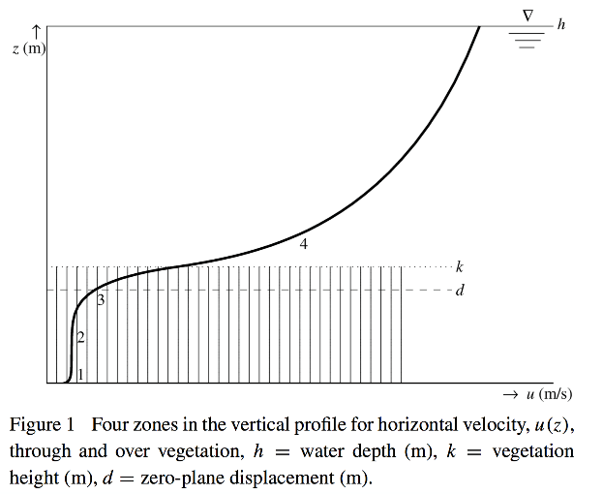
Friction by vegetation
Baptist, et al. 2007. On inducing equations for vegetation resistance. Journal of Hydraulic Research 45:435-450.

Slide 26
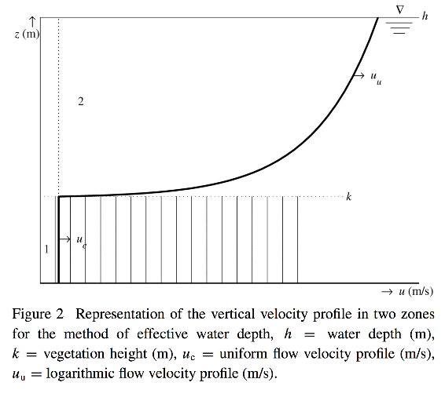
Friction by vegetation-abstracted
Baptist, et al. 2007. On inducing equations for vegetation resistance. Journal of Hydraulic Research 45:435-450.

Slide 27
Calculating friction of vegetation
When the vegetation is emerging from the water (like, e.g. with reeds), the entire water collum is occupied by water. In that case, the Chézy coefficient is given by:
here C_{b} is the Chezy roughness of the bare bed, C_{d} is the drag coefficient of the vegetation, D_{v} is the vertical vegetation density.
When the vegetation is submerged, part of the water column is free, and the Chézy coefficient is given by:
Here H_{v} is the vegetation height, and κ is the Von Kármàn constant (0.4).

Slide 28
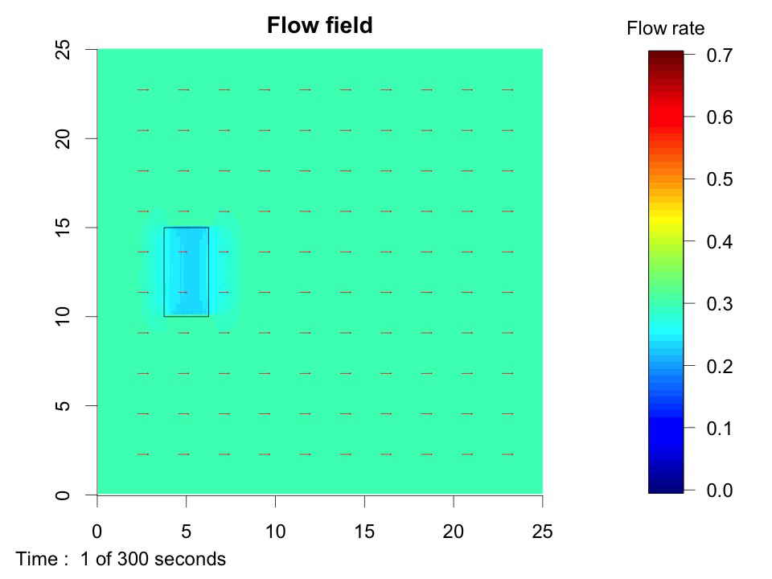
A simple model

Slide 29
Assignments
Taking the shallow water equation
Make a model of wave formation (maybe in 1D) and how it hits the coasts, comparing with or without tidal flat or salt marsh (easy).
Make a model of a pipe from a nuclear power plant pumping warm water in a flowing body of water
Make a model that takes a vertical slice rather then a horizontal slice, and do one of the following
What happens of the wind makes the top water layer water move
What happens to the warm water originating from vulkanic seeps

